Slide 1

Metadata Mapper
Em Stelter / IMT 542 Final Project / SPR 2026
Notes:
Hi there, my project is on scraping and converting the structure of fanwork metadata for ArchiveofOurOwn.org for availability for visualization.

Slide 2
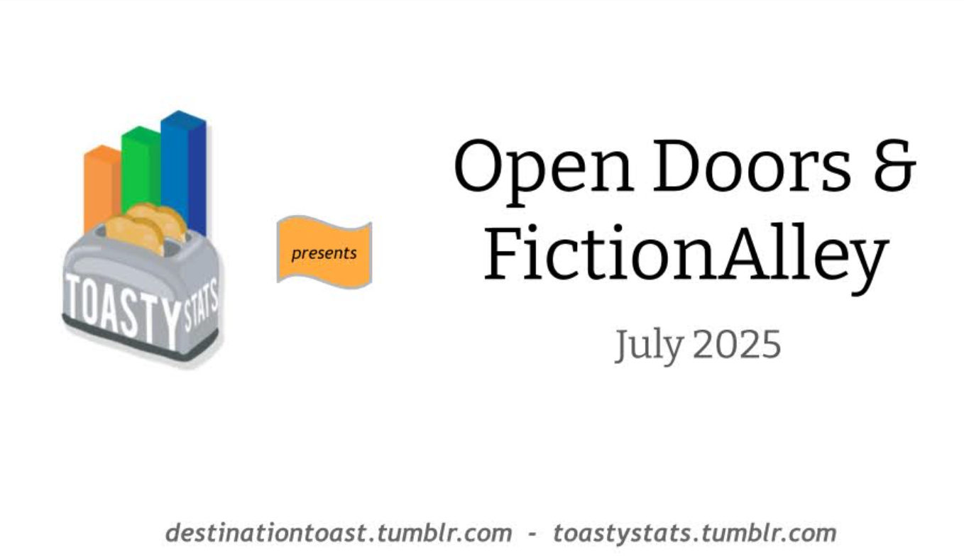
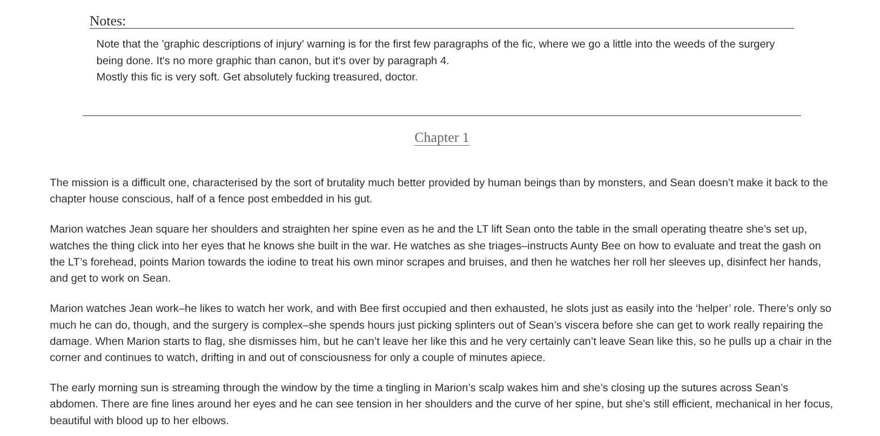
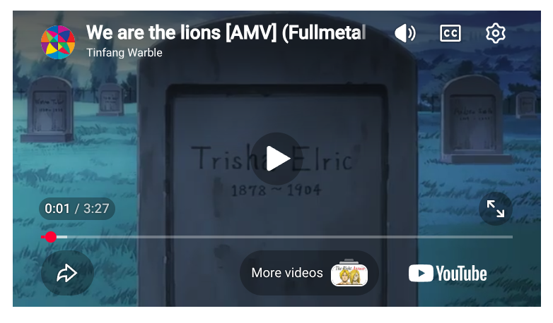
Info Story: Ao3
Archive of Our Own (Ao3) - preeminent digital repository for fanfiction and other transformative fanworks, run by the nonprofit Organization for Transformative Works (OTW)
Fanworks - Works of writing, visual art, music, multimedia, and critical analysis (among other forms of expression) made by fans using the source material of an existing story.
Notes:
Background:
archiveofourown.org, or Ao3, is the preeminent digital repository for fanfiction and other transformative fanworks, run by the Organization for Transformative Works.
Broadly, fanworks are works of writing, visual art, music, and critical analysis (among other forms of expression) made by fans using or examining the source material of an existing story. Fan communities come together over a shared love of or interest in a common IP, story, source material, etc. Fanworks are made to celebrate, analyze, critique, iterate upon, and generally be in conversation with that source material and with each other.
Image sources:
https://archiveofourown.org/works/51518734/chapters/130205587
https://archiveofourown.org/works/86018096
https://archiveofourown.org/works/68067611

Slide 3
“The Organization for Transformative Works (OTW) is a nonprofit organization, established by fans in 2007, to serve the interests of fans by providing access to and preserving the history of fanworks and fan culture in its myriad forms. We believe that fanworks are transformative and that transformative works are legitimate.”
About the OTW, https://archiveofourown.org/about
Notes:
This is the OTW’s mission statement: “The Organization for Transformative Works (OTW) is a nonprofit organization, established by fans in 2007, to serve the interests of fans by providing access to and preserving the history of fanworks and fan culture in its myriad forms. We believe that fanworks are transformative and that transformative works are legitimate.”
So information access is fundamentally baked into Ao3’s mission from its founding as one of the OTW’s main projects.

Slide 4
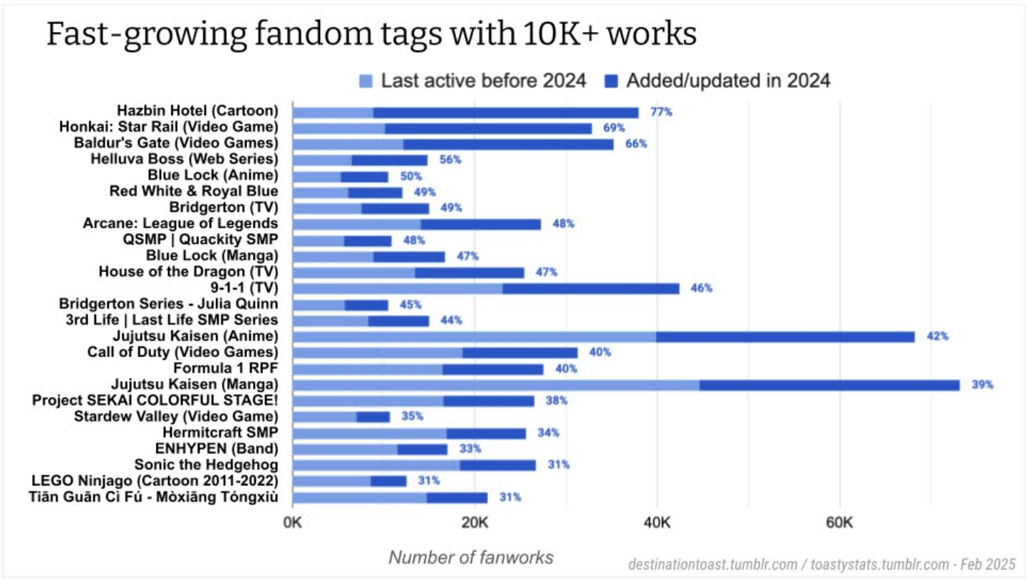
Info Story: Fandom Meta Analysis
“What do a fan community’s collective works say about their relationship to their fandom’s source material?”
Notes:
I’m assuming folks here have generally encountered or heard of fanfiction, fanart, fan videos, etc., but one sometimes overlooked type of transformative work is Fandom Meta Analysis.
Fandom meta analysis essentially asks the question, “What do a fan community’s collective fanworks say about their relationship to their fandom’s source material?” For example, if the Game of Thrones fandom is full of a bunch of fluffy alternate universe romances—for a source IP that is notoriously grimdark and violent—that says something interesting about the Game of Thrones fandom, and fans’ relationship to the story of Game of Thrones. (Although with Game of Thrones I think it’s more likely to be full of stories that diverge from canon starting just before Season 8.)
Might involve written or video essays, podcasts, etc.; might involve data analysis and visualization. For example, the image on the right is from Ao3 user toastystats, and their meta analysis report, “[Fandom stats] Biggest fandoms, ships, and characters on AO3: Looking back at 2024” (https://archiveofourown.org/works/62863873).
Right now, as far as I’ve been able to find, there aren’t any official or unofficial tools for exporting and analyzing Ao3 fanwork metadata – which is highly interesting for meta analysis, because Ao3 metadata (as we will see in a second) holds a lot of information about a fanwork’s contents.
I was able to find some tutorials for meta analysis—for example, toastystats provides tutorials on how to identify the most prolific Ao3 fandoms (ToastyStats tutorials: https://archiveofourown.org/works/27804601/chapters/68071009) —but their methods involve a lot of copy/pasting directly from Ao3; there don’t seem to be a lot of automated tools.
There is an unofficial command line tool for bulk-downloading whole fics from Ao3 called ao3downloader, developed by Github user nianeyna. (Archive of Our Own allows users to download fanworks in ereader formats; ao3downloader is a python script that can download fics in bulk. I have used ao3downloader pretty extensively in the last couple years; however, bulk downloading can be a lengthy process if you’re not actually interested in more than the metadata.
Image source: https://archiveofourown.org/works/62863873
ToastyStats tutorials: https://archiveofourown.org/works/27804601/chapters/68071009

Slide 5
Ao3 Metadata Mapper (Ao3MM)
What does it do? - Scrapes, organizes, and visualizes Ao3 fanwork metadata
Project Goals - To support fan community meta analysis, and provide a tool for fans without a robust technical background who want to include Ao3 data visualization in their meta analysis
Notes:
Ao3 Metadata Mapper is a tool that scrapes, organizes, analyzes, and visualizes fanwork metadata from Archive of Our Own (Ao3). Ao3MM is basically a digital humanities support tool, to help users analyze trends in the collective fanworks of any fandom with a presence on Ao3.
The goal of AO3MM is to support fan community members who love to do meta analysis, i.e. studying and analyzing their community’s fanworks. Ao3MM supports fans without a robust technical background who want to include Ao3 data visualization in their meta analysis.

Slide 6
Ao3MM: Broad Steps
Scrapes Ao3 fandom webpage to get pagination links (multiple pages of search results)
Scrapes pagination links for fanwork links
Scrapes fanwork links for desired metadata, organizes metadata into dictionaries, compiles individual dictionaries into a nested dictionary
Converts nested dictionary to a JSON array; saves the JSON file to local storage
Generates visualizations: loads the saved JSON file, converts it to a dataframe, and plots visualizations to analyze the metadata
Notes:
Ao3 Metadata Mapper organizes fanwork metadata in a JSON array. Ao3MM generates the JSON array in the following steps:
First, it takes in the first webpage of an Ao3 fandom (example: https://archiveofourown.org/tags/Candela%20Obscura%20(Critical%20Role%20Web%20Series)/works) and scrapes the page for a list of “pagination links” (box circled in red below). The combined pagination links contain links to all the fanworks for the given Ao3 fandom, but each pagination link only displays 20 fanworks. I have not yet found a reliable way in Ao3’s UI to display all fanwork links on a single page, so it’s necessary to scrape for a list of individual pagination links.
Second, for each pagination link, Ao3MM scrapes the webpage for a list of links to the 20 fanworks on that page.
Third, for each fanwork link, Ao3MM scrapes the page for the desired metadata, then organizes the metadata into a dictionary. Ao3MM then compiles the individual fanwork dictionaries into a nested dictionary.
Fourth, Ao3MM converts the nested dictionary of all fanwork metadata into a JSON array and saves the JSON file to local storage for safekeeping.
Last, Ao3MM loads the saved JSON file, converts it to a dataframe, and uses plotly.express to generate visualizations of the saved metadata.

Slide 7
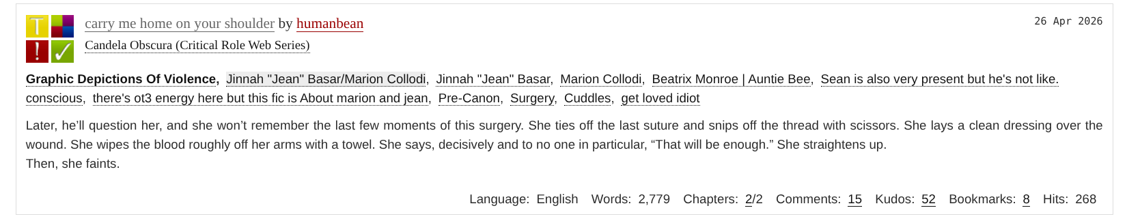
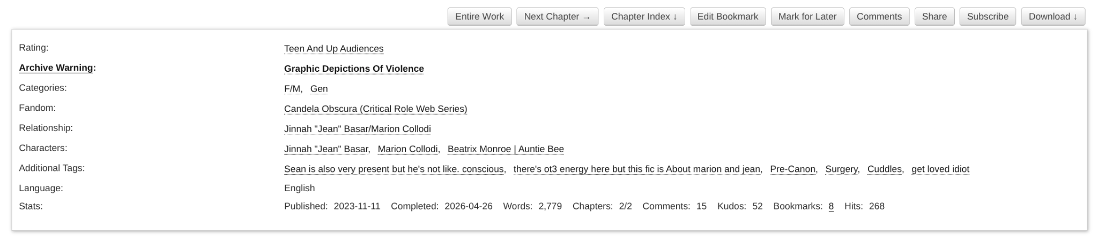
Existing Information Structure
Notes:
These images show how metadata appears directly on Ao3.
The top image shows how metadata appears in Ao3’s search results
The bottom image shows how metadata appears in the header of an individual fanwork page

Slide 8
Existing Information Structure
<div class="wrapper">
<dl class="work meta group">
<dt class="rating tags">
Rating:
</dt>
<dd class="rating tags">
<ul class="commas">
<li><a class="tag" href="/tags/Mature/works">Mature</a></li>
</ul>
</dd>
<dt class="warning tags">
<a href="/tos_faq#tags">Archive Warning</a>:
</dt>
Snippet of BeautifulSoup object for one Ao3 fanwork after scraping the html document.
Notes:
Here is a small snippet of the BeautifulSoup object for one Ao3 fanwork after scraping the html document. I’ve highlighted in red one of the metadata elements of interest, which is the fanwork rating. (Which is analogous to TV content ratings like PG-13, R, etc.) Obviously this is a bit of a nightmare to parse just reading through it with the naked eye.

Slide 9
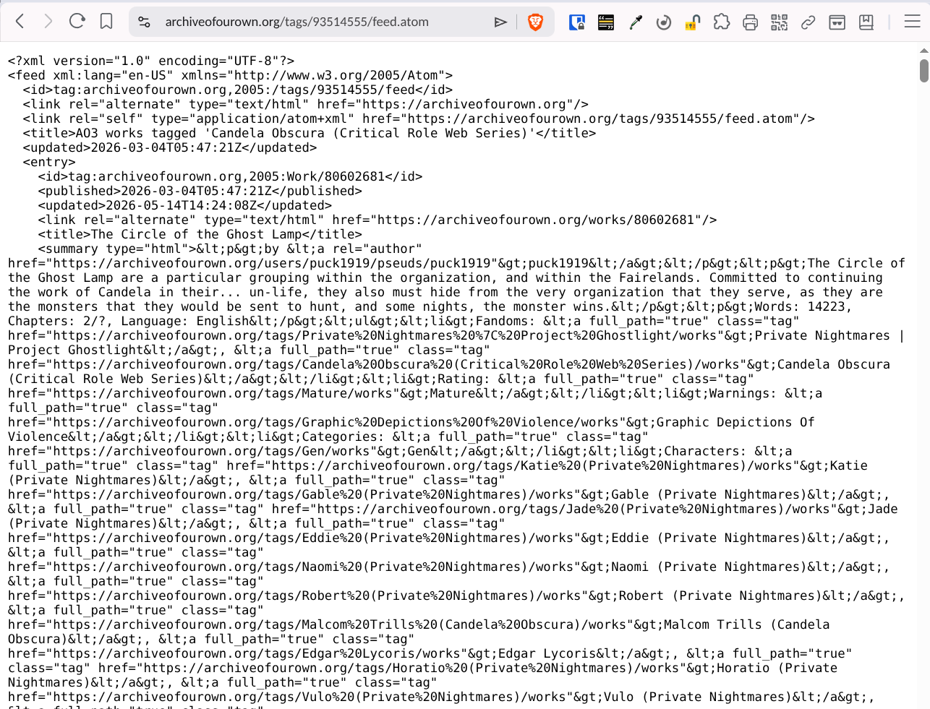
Existing Information Structure
RSS Feed for the fandom tag “Candela Obscura (Critical Role Web Series),” accessed June 2026
Notes:
One of the methods I first considered for accessing metadata was using the RSS feed for an Ao3 fandom tag. (On Ao3 every fandom has a tag; all works tagged with that fandom tag appear in the search results for the tag, and each fandom tag has an associated RSS feed that readers / fans can use to subscribe to particular fandoms.) If this had worked, the process of extracting the metadata would have taken fewer steps; however:
The problem with the RSS feed is that it only contains the 25 most recent fanworks, and there is not a reliable way to access works posted earlier.
A few metadata elements that are potentially really intriguing for analysis do not appear in the RSS feed, including kudos, comments, hits, and bookmarks, all of which indicate reader engagement and interest. So if you wanted to analyze the metadata to analyze what kinds of fics are most read or “liked” in a particular fandom, that would not be possible with the RSS feed data.

Slide 10
F.A.I.R. Assessment
 | Strengths | Areas of Improvement
F | Persistent & globally unique identifiers (F1) Rich metadata provided (F2) | Metadata not easily harvested and indexed (F4)
A | Metadata accessible via human intervention and resolves to a digital record (A1) Data available through free access protocol (A2) | No standardized access protocol for metadata (A1) Metadata not guaranteed to remain available after data is no longer available (A2)
I | Metadata references other metadata (I3) Data uses standardized & machine-understandable knowledge representation (I1) | Metadata doesn’t use machine-understandable knowledge representation (I1)
R | Metadata and data comply with human community standards (R1.3) | No standard / machine readable reuse license (R1.1)
Notes:
For the most part, Ao3 data (fanworks) and metadata do pretty well when assessed with F.A.I.R. criteria. This chart shows some of the most significant strengths and areas of improvement. For the sake of time, I’m not going to go through all of these. I mainly want to highlight Accessibility:
Accessibility is the main area where Ao3 doesn’t do as well with FAIR.
Strengths:
Metadata is accessible via human intervention and resolves to a digital record (A1)
Data is available through free access protocol (A2)
Areas of Improvement: There are no standardized access protocols for metadata (A1). There isn’t an easy way to download Ao3’s metadata tags in bulk. This is partly because Ao3’s metadata tags are organized in a partial folksonomy. There are some metadata categories that have standardized tags. (For example, Archive Warnings, which are essentially content warnings for sensitive or potentially upsetting subject matter, come from a controlled list.) But Ao3 users have access to a “freeform tags” field where they can add whatever tags they want. Ao3 has a team of volunteer “tag wranglers” who manage Ao3’s “Canonical Tags”, which become “canonized” into controlled lists of Fandoms, Characters, Relationships, or Additional Tags. Tag wranglers identify freeform tags that are synonymous or related to Canonical Tags and connect them within Ao3’s taxonomy. So Ao3’s metadata taxonomy is constantly changing. That said, there still isn’t an easy way to identify this.
No standardized access protocol for metadata (A1)
Metadata not guaranteed to remain available after data is no longer available (A2)
Findability - Otherwise, Ao3’s data and metadata are largely pretty findable. All fanworks and metadata tags have persistent, unique identifiers in the form of Ao3 URIs.
Interoperability - Ao3’s data and metadata are pretty interoperable. Because of the tag wranglers, Ao3’s metadata contains references to other metadata, and data (fanworks) use standardized & machine readable knowledge representation. (I.e. fanworks can be read by a human but they can also be downloaded in standard ereader formats directly from Ao3). Although Ao3’s metadata does not have an analogous machine-understandable knowledge representation.
Reusability - Metadata and data comply with human and machine-readable community standards.
In my experience, Ao3 is a website where users are typically searching more than they are browsing. If somebody knows about Ao3 and wants to read Ao3 fanfiction, they probably already know what fandoms they’re interested in, what kinds of content they are interested in (or not interested in), which characters and relationships they want to read about, etc. Ao3 is essentially a library; it excels at making information findable if you know what you’re looking for. If you don’t know what you’re looking for, the site can be more challenging to use.
Again, the most significant barrier to Ao3 fandom meta analysis is metadata accessibility.

Slide 11
Baseline Metadata Structure (as appears on Ao3)
Notes:
So to recap, using Ao3MM, the metadata structure from an Ao3 page transforms from this (baseline structure as viewed with the naked eye)…

Slide 12
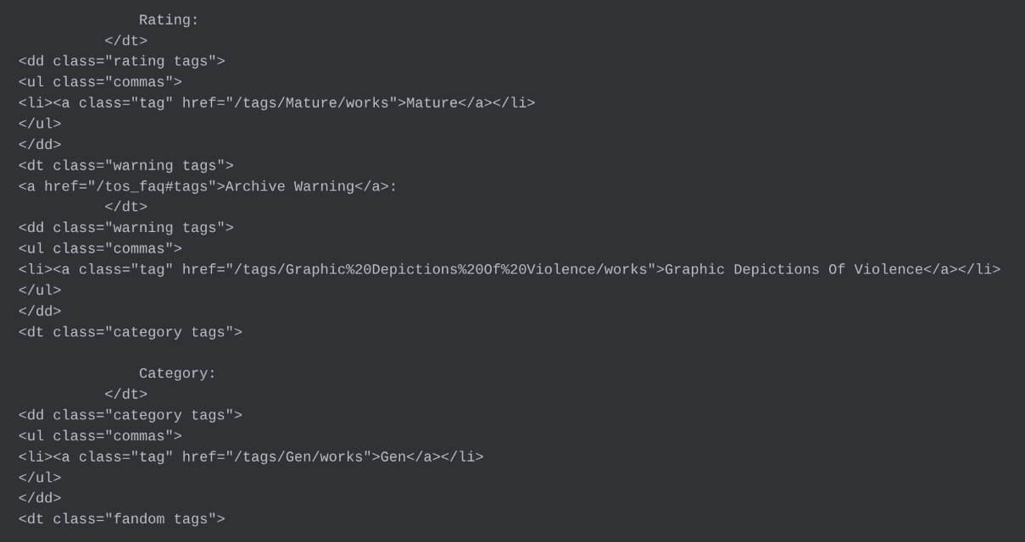
Intermediate Metadata Structure (HTML, after web scraping)
Notes:
…to this (html after web scraping)...

Slide 13
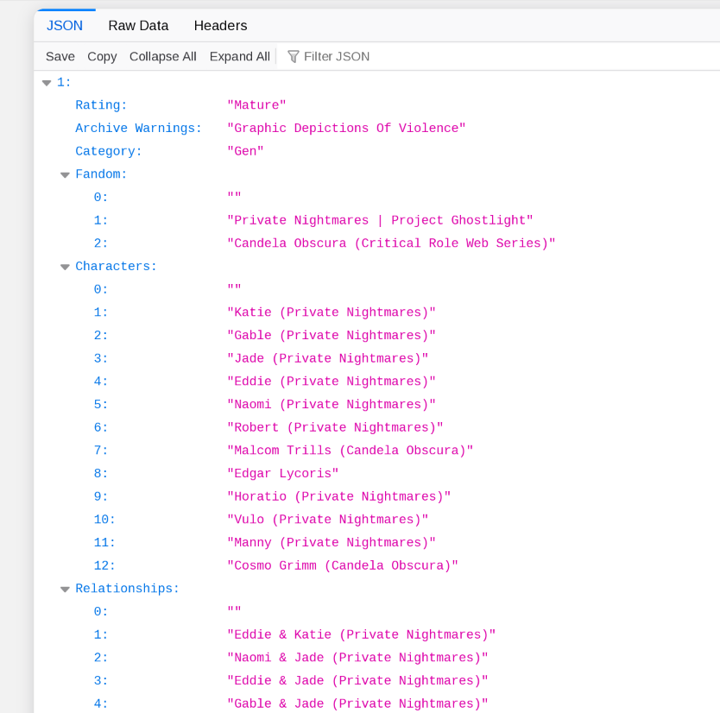
Improved
Metadata Structure
(after parsing HTML text and converting to JSON array)
Notes:
…to this: the final JSON array after parsing the HTML text and extracting relevant metadata.
Now if a fan wants to analyze Ao3 fanwork metadata, they have an easily portable file that they can take, convert to a dataframe, and use as a basis to create visualizations…

Slide 14
Metadata Elements
Ratings Archive Warnings Category Fandom Characters Relationships Additional Tags Is_Series Date Published Date Updated Word Count Chapter Count Comment Count Kudos Count | Content ratings from Ao3 controlled list (e.g. “Teen” or “Mature”) Sensitive content warnings from Ao3 controlled list (e.g. “Major Character Death” Indicates gender dynamic of main relationship depicted (e.g. F/F) Indicates source material intellectual property (e.g. “Star Wars”) Which characters are depicted in the fanwork (e.g. “Jabba the Hutt”) Which character relationships are depicted in the fanwork (e.g. “Sherlock Holmes / John Watson,” Happy Pride) Freeform tags - might indicate specific content or tropes (e.g. “Friends to Lovers”) or author commentary (“No beta we die like men”) Indicates whether the fanwork is part of a series of fanworks Original date published Date updated (if multichapter, or if the author has made further edits) Self-explanatory; most relevant for written works # published chapters vs. # planned chapters (indicates completeness) Number of reader comments on fanworks; indicates engagement (Essentially) number of “likes” on fanworks; indicates engagement
Notes:
FOR REFERENCE ONLY
Ratings: content ratings from Ao3 controlled list - Not Rated, General Audiences, Teen, Mature, Explicit
Archive Warnings:
Graphic Depictions of Violence - fanwork contains depictions of graphic violence
Major Character Death - fanwork contains depiction(s) of a major character death
Rape/Non-Con - fanwork contains depictions of rape or non-consensual sex
Underage Sex - may refer to underage characters engaging in sexual acts, or may refer to sexual acts between adult and underage characters
Creator Chose Not to Use Archive Warnings - fanwork may contain sensitive content as described above, but the fan author has chosen not to include content warnings
No Archive Warnings Apply: fanwork contains none of the sensitive content described above
Category - Indicates the gender dynamic of the main relationship depicted in the fanwork, from a controlled list defined by Ao3, including: F/F - main relationship, often but not always romantic, is between at least two female-identified characters; F/M - main relationship, often but not always romantic, is between at least one female-identified and one male-identified character; M/M - main relationship, often but not always romantic is between at least two male-identified characters; Multi - indicates multiple relationships with different gender configurations; Other - may indicate no character relationships, only platonic relationships, relationships involving nonbinary / genderqueer / otherwise gender-diverse characters, etc.; Gen - typically indicates only platonic relationships depicted
Field
Definition
Rating
Content ratings (from Ao3 controlled list, e.g. “Not Rated”, “General Audiences,” “Teen”, “Mature,” “Explicit”)
Archive Warning
Sensitive content warnings - from Ao3 controlled list (e.g. “Graphic Depictions of Violence”
Category
Gender dynamic of main relationship depicted in the fanwork, from Ao3 controlled list (e.g. F/F, F/M, M/M, Multi, Other
Fandom
Name of the intellectual property (e.g. book, movie, TV show, web series, video game, etc.) whose characters and/or setting is depicted in the fanwork.
Characters
Name(s) of the primary characters depicted in the fanwork (e.g. “Captain Jean-Luc Picard”).
Relationships
Name(s) of the primary character relationships depicted in the fanwork (e.g. “Captain Jean-Luc Picard/Q”).
Additional Tags
Any additional freeform tags that the author chose to include. Freeform tags may be used for additional content warnings or flags, to indicate background characters not tagged under “Characters”, to specify a particular genre or trope depicted in the work, or even for the author to provide commentary about the work and their experience writing it.
Is_Series
Indicates whether the fanwork is part of a series of works.
Date Published
The date the fanwork was first published.
Date Updated
The last date the fanwork was updated, e.g. if the author added chapters after the original publication date, or if the author made edits to the original fanwork.
Word Count
The number of words in the fanwork (typically a prose story).
Chapter Count
The total number of chapters in the work, at least 1, and the total number of planned chapters in the work (e.g. “1/1” - indicates a complete fanwork where only one chapter was planned; “2/?” - indicates a likely incomplete fanwork where the author has not planned a set number of chapters but has posted at least two; “50/50” - indicates a likely complete fanwork where the author has planned and completed 50 chapters.)
Comment Count
The total number of comments left on the work by readers. Indicates reader engagement and interest.
Kudos Count
The total number of kudos left on the work by readers. (Kudos are akin to “likes” - you click a heart-shaped button at the bottom of the fanwork page and the kudos count for the fanwork increases.) Indicates reader approval and interest.

Slide 15
Quality Assessment Methods for Ao3MM
In progress / still working out some of the kinks in the code
Can reliably:
Ingest an individual fanwork link, parse & extract metadata elements, and convert them to the JSON structure shown
Do the same with lists of fanwork links in small batches (e.g. one set of 20 fanwork links from an individual pagination link), then merge the separate JSON links into a single JSON array
Struggles to:
Digest and process a large batch of fanwork links without missing data
Notes:
In terms of assessing and maintaining the quality of the system - I am admittedly still working out some of the kinks in the code; this is an area where I’m a little behind (so please be nice).

Slide 16
Functional Testing
Test Case | Description / Method | Expected Result
Single fanwork | Input single fanwork link (rather than a list of works to iterate through); open output JSON document to validate visually (does not require get_pagination_links or get_fanwork_links steps scripts) | Returns nested JSON array of length=1 populated with data from single fanwork; no “Unknown” fields
Subset of fanworks list | Input list of 10 fanworks; open output JSON document to validate visually (does not require get_pagination_links script) | Returns nested JSON array of length=10 populated with data from 10 fanworks; 1 or fewer entries only contains “Unknown” fields (i.e. no metadata was successfully scraped)
Full fanworks list | Input link to the first page of an Ao3 fandom with 100+ fanworks; script counts number of entries with “Unknown” fields (requires both get_pagination_links and get_fanwork_links scripts) | Returns nested JSON array of length=n (total number of fanworks returned in Ao3 search results); 10% or fewer entries contain “Unknown” fields (i.e. no metadata was successfully scraped)
Notes:
Note: these are the functional tests I’ve been running as I’ve been developing and debugging my code, and these are the tests I would expect another hobbyist fan to run when using Ao3MM to build their own visualizations. If I were to implement this as a product for market / on a larger scale, I would incorporate more automation. However, the expectation here is that individuals will use this code to generate fanwork visualizations on a one-off basis, or perhaps a semi-regular cadence, but Ao3MM is not so much intended for daily use as it is for individual meta analysis projects.

Slide 17
Thank you!

